Slide 1
Pointer
Dr. Eman Mounir
Eng. Gehad Mustafa
Eng. Eman Samy

Slide 2
pointer
Pointer variable is a variable that holds address values
Each data type has its own pointer variable (pointer to int, pointer to char,..)
Operator & to get the address of variable
Operator * to access the value of the variable pointed

Slide 3
Pointer
data_type_of_pointer * name_of pointer;
data_type_of_pointer * name_of_pointer= & name_of_variable;
data_type_of_pointer * name_of_pointer;
name_of pointer= & name_of_variable;

Slide 4
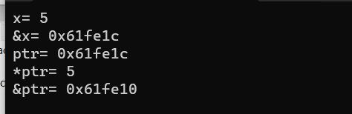
EX
int x=5;
int*ptr;
ptr=&x;
cout<<"x= "<< x <<endl;
cout<<"&x= "<< &x <<endl;
cout<<"ptr= "<< ptr <<endl;
cout<<"*ptr= "<< *ptr <<endl;
cout<<"&ptr= "<< &ptr <<endl;

Slide 5
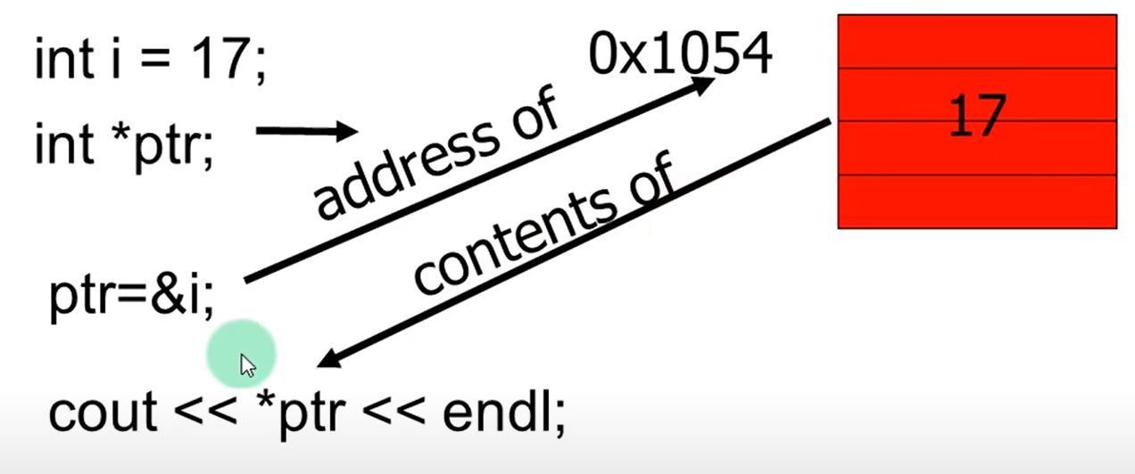
Ex

Slide 6
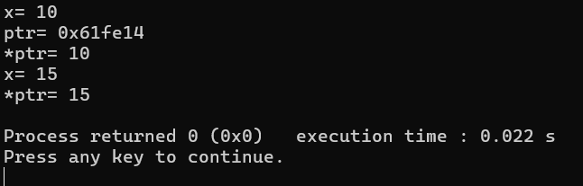
Operators
int x=10;
int*ptr=&x;
cout<<"x= "<< x <<endl;
cout<<"ptr= "<< ptr <<endl;
cout<<"*ptr= "<< *ptr <<endl;
*ptr+=5;
cout<<"x= "<< x <<endl;
cout<<"*ptr= "<< *ptr <<endl;

Slide 7
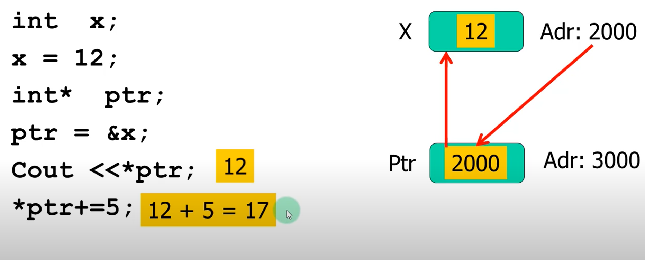
Operators
17

Slide 8
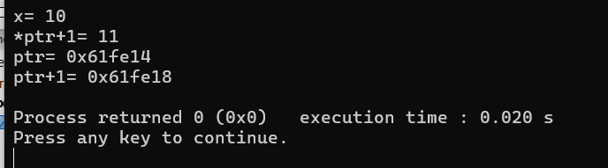
Operators
int x=10;
int*ptr=&x;
cout<<"x= "<<x<<endl;
cout<<"*ptr+1= "<<*ptr+1<<endl;
cout<<"ptr= "<<ptr<<endl;
cout<<"ptr+1= "<<ptr+1<<endl;

Slide 9
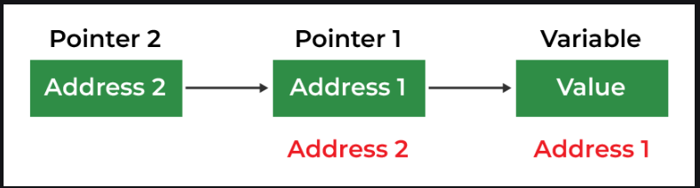
Pointer to pointer
the first pointer is used to store the address of the variables, and the second pointer stores the address of the first pointer.
this is known as a Double Pointer or Pointer to Pointer.

Slide 10
Pointer to pointer
data_type_of_pointer **name_of_variable = & normal_pointer_variable;
int val = 169;
int *ptr = &val; // storing address of val to pointer ptr.
int **double_ptr = &ptr; // pointer to a pointer declared which is pointing to an integer.

Slide 11
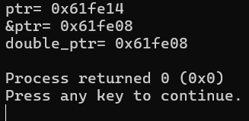
EX
int val = 169;
int *ptr = &val;
int **double_ptr = &ptr;
cout <<"ptr= "<<ptr<<endl;
cout <<"&ptr= "<<&ptr<<endl;
cout <<"double_ptr= "<<double_ptr<<endl;

Slide 12
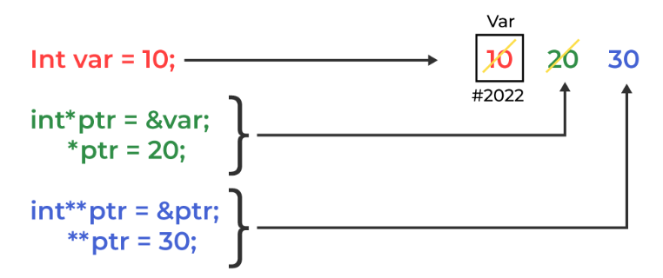
Try

Slide 13
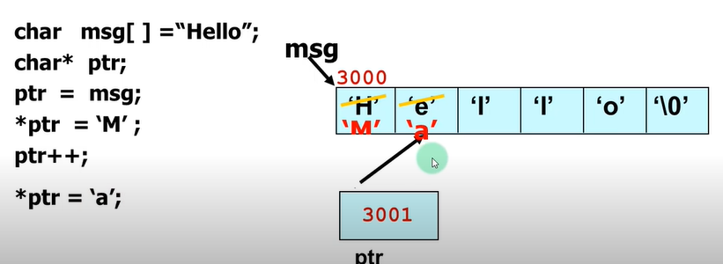
Using pointer to access the element of string

Slide 14
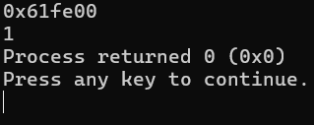
Pointer and Array
Array can be accessed using pointer
The name of array is also constant pointer to the data of the element stored in the array
int x[5]={1,2,3,4,5};
cout<<x<<endl;
cout<<*x<<endl;

Slide 15
Try
Try to print this array using pointers:
Arr=[1,2,3,4,2,5,4]

Slide 16
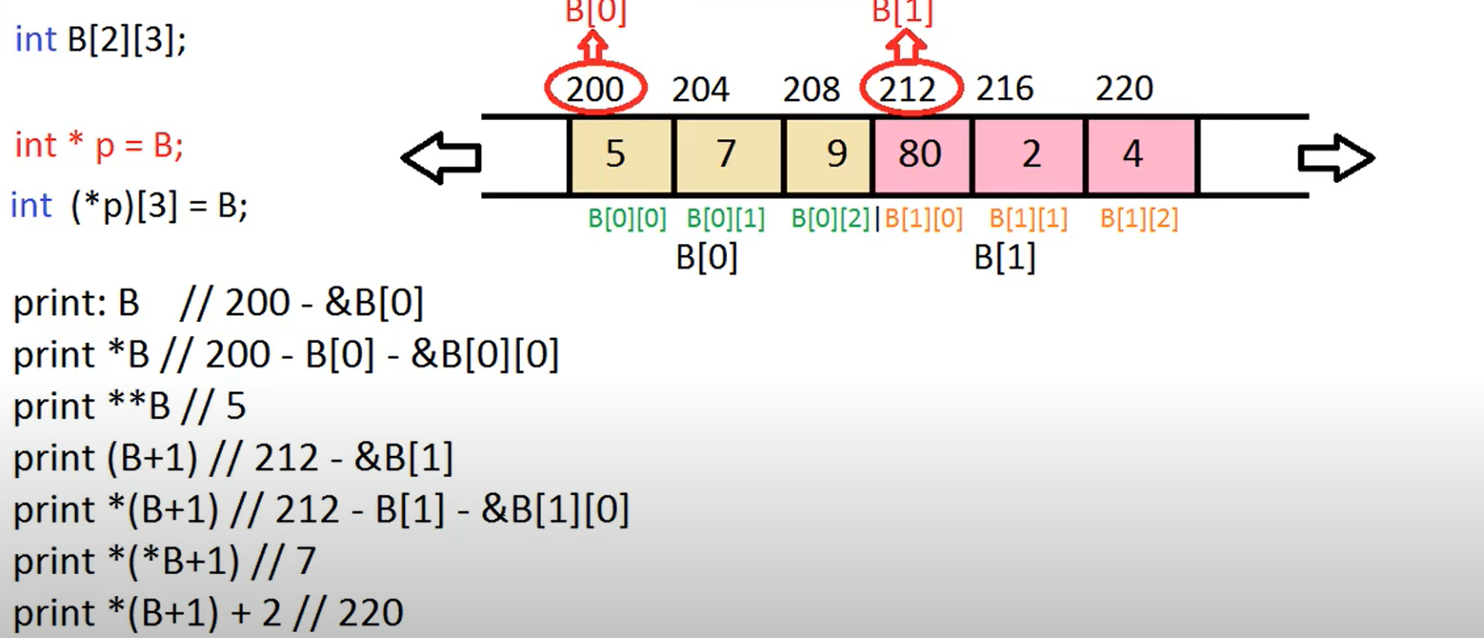
Pointer and Array 2-D Try it

Slide 17
Call function
By value : void f(int x)
By reference : void f(int &x)
By pointer : void f(int*x)

Slide 18
Call by value
In passing by value the function obtains only a local copy of the variable, so that changes to the local variable have no impact on argument with which the function was invoked

Slide 19
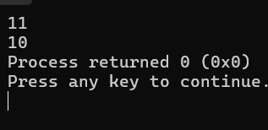
EX
#include <iostream>
using namespace std;
void increment(int n){
n+=1;
cout<<n<<endl;
}
int main() {
int x=10;
increment(x);
cout<<x;
return 0;
}

Slide 20
Call by reference and pointer
In passing by reference and passing by pointer the function manipulates the original variable rather than only copy of it

Slide 21
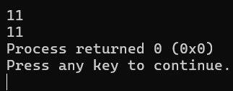
EX call by reference
#include <iostream>
using namespace std;
void increment(int&n){
n+=1;
cout<<n<<endl;
}
int main() {
int x=10;
increment(x);
cout<<x;
return 0;
}

Slide 22
EX call by pointer
#include <iostream>
using namespace std;
void increment(int*n){
*n+=1;
cout<<*n<<endl;
}
int main() {
int x=10;
increment(&x);
cout<<x;
return 0;
}

Slide 23
Try
Write swap function
Using value
Using reference
Using pointer

Slide 24
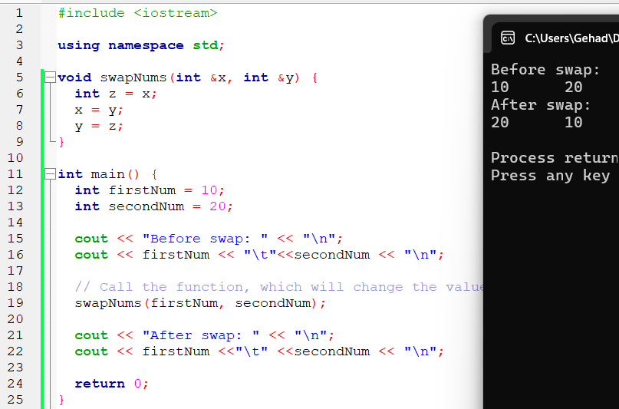
Using reference

Slide 25
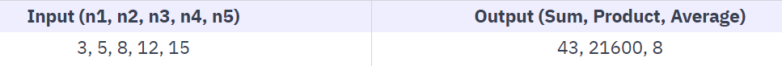
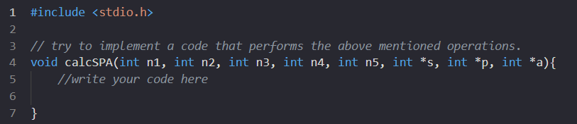
Try
Write a function that takes in five numbers as parameters along with three pointers. Calculate the sum, product, and average of the five numbers, and store each result in their respective pointers.

